Slide 1



Privacy Consent on FHIR (PCF) Public Comment
John Moehrke
<JohnMoehrke@gmail.com>
Co-Chair: IHE ITI Planning Committee

Slide 2
Why does PCF exist?
Given Document Sharing – MHDS, XDS and XCA
Basic Patient Privacy Consents (BPPC) and Advanced Patient Privacy Consents (APPC) are founded on CDA and XACML
So need a more FHIR friendly solution.
And FHIR has a Consent Resource available
State of the art for Consent and Access Control has improved

Slide 3
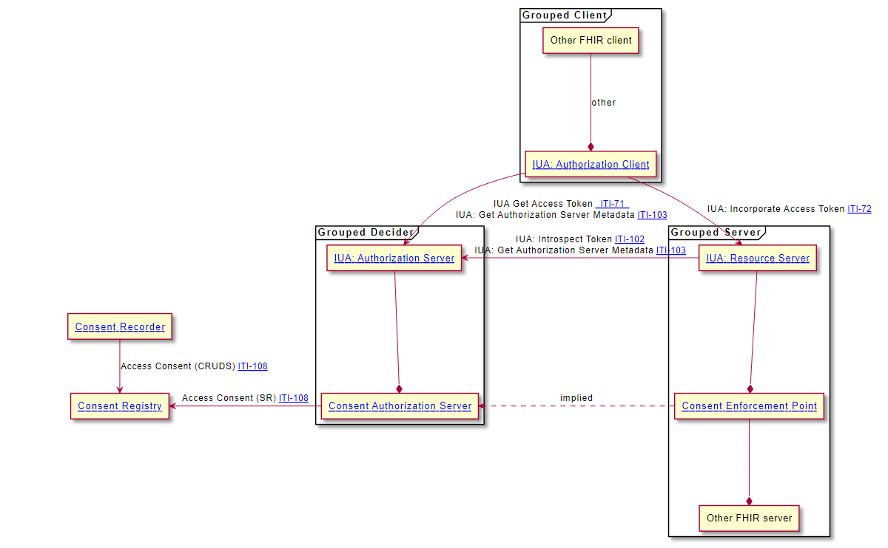
Major parts of PCF
Volume 1: Actors, Transactions, and Options
Relationship of Consent to Access Control
Access Control decisions and enforcement
Leveraging the Internet User Authorization (IUA) profile of oAuth
Consent: Basic, Intermediate, and Advanced
Volume 1: Appendix P: Privacy Access Policies, Obligations/Refrains, FHIR Consent basics, and Security Labeling Service
Volume 2: Consent resource: creating, updating, search, and delete
Other: Updates to IUA ITI-71 transaction to carry consent decisions and residual rules to enforce

Slide 4
Open Issues
PCF_18: Advanced required sensitivity codes.
In the Advanced is a required subset of ConfidentialityCodes (N, R), and Sensitivity codes (ETH, ETHUD, OPIOIDUD, PSY, SEX, and HIV). Is this enough? Is this too many? What should be required of the PCF? Note that required in the PCF does not mean that a deployment implementation must use all of these codes.
There is likely no minimal set that is universally globally required. After Public-Comment the current list of Sensitivity Codes that are mandatory is likely to be trimmed. Should the sensitivity classifications that are moved out of the mandatory requirement still listed as a useful mention?
PCF_19: Should Basic include agent authored by the Consent
The Basic Explicit Option includes the ability for the Consent to identify a list of agents (device, relatedPerson, Practitioner, or Organization) that would be authorized by the Consent. This was supported by BPPC, so was considered Basic. However this has been identified as an unusual need today and thus would be more appropriate to be in the Intermediate group. Please comment on if you find this needed and agree that it should be in Basic, or if this support should be in Intermediate.
PCF_20: Should PCF include break-glass when there is no clear way to declare break-glass
There is support in a Consent for provisions when break-glass is declared, and there are support for conveying break-glass between the decision and enforcement. However, there is no clear way to declare break-glass, or to inform a client that the user is authorized to declare break-glass and would get access to more data.
There are many ways envisioned to declare break-glass:
PCF_21: Should Provenance be recommended or required?
ITI-108 includes requirements to record AuditEvents, using BALP pattern. This is considered sufficient to track inappropriate changes, and is referenced in the Security Considerations. Should there also be requirements to record Provenance on Create, Update, and Delete in addition to AuditEvent?

Slide 5
Public Comment
https://profiles.ihe.net/ITI/
Please comment on the Open Issues
Please comment on the oAuth profiling
Please comment on the set of example Consents, including offering a consent we might have missed.
Please note any readability or quality issues
Please recommend better explanation
Please recommend better diagrams and figures

